Slide 1
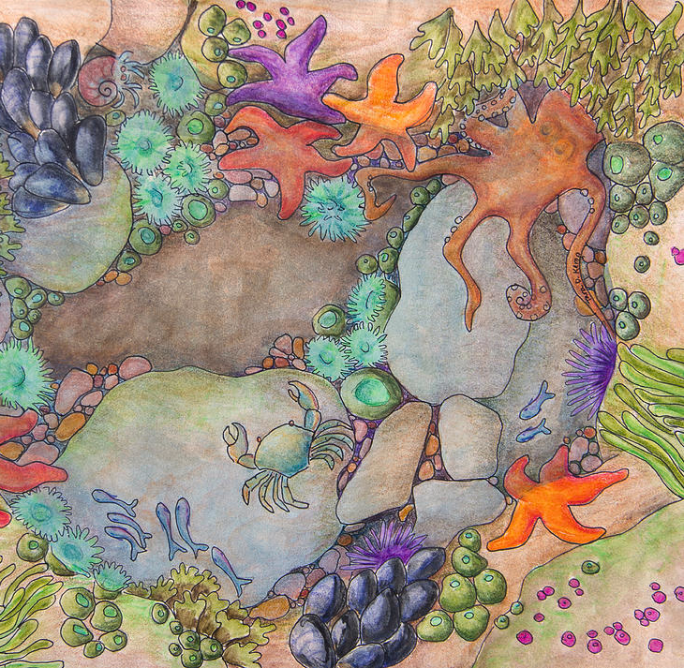
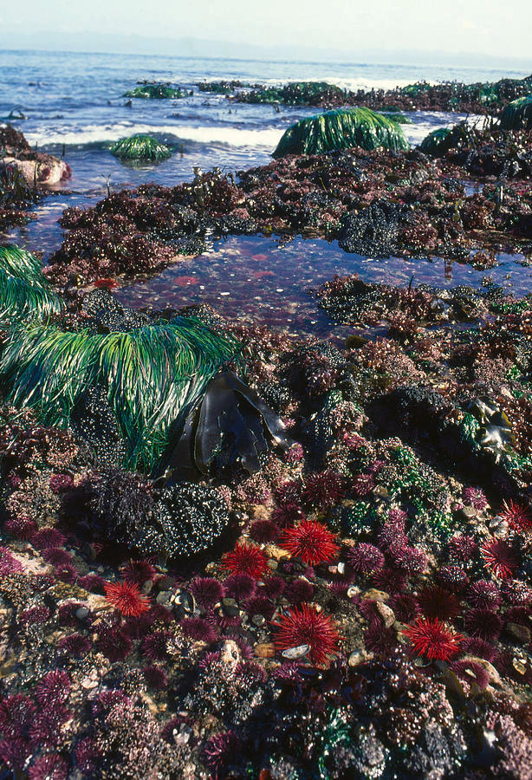
Teacher Guide
Session 3:
Tide pool biodiversity
(Activities for 5th+ grade students)
Created by:
Brittany Bennett
Holland Elder
JL Weissman
Jesse McNichol
Nicole Ratib
Suzana Leles
Trang Nguyen

Slide 2
Learning Objectives
Goals: Students will get experience calculating a simple biodiversity index using a tide pool as a sample habitat
Learning Objectives:
Upon completion of this activity, students will:
Be able to define biodiversity
Understand why biodiversity is important to ecosystem health
Visually identify species found in a tide pool habitat (using simplified “Transect Sampling” approach)
Calculate tide zone habitat’s biodiversity level using a simple equation
Speculate on the overall health of a tide pool habitat
Overall steps:
For each habitat, students will examine 8 sub-sections of a tide pool habitat study site (as assigned). They will then:
Use identification key to identify and record the species in each section of the study site
Count and record on the worksheet the number of each species in each section of the two study sites and how many sections they are found on each site
Calculate the total number of each species on the whole study site
Use this information to calculate a basic biodiversity index for the tide pool habitat using worksheet provided
Speculate on the overall health of the two tide pool study areas
Source material:
Biodiversity of a tide pool habitat https://www.exploringnature.org/db/view/Biodiversity-of-a-Tide-Pool-Habitat-Inquiry-Activity
Helpful video about tide pools: https://www.youtube.com/watch?v=fk4-GTrBtJY
Students will need:
1 ruler
1 pencil
A tide pool organism key
Printed worksheets
2 images of 2 study sites

Slide 3
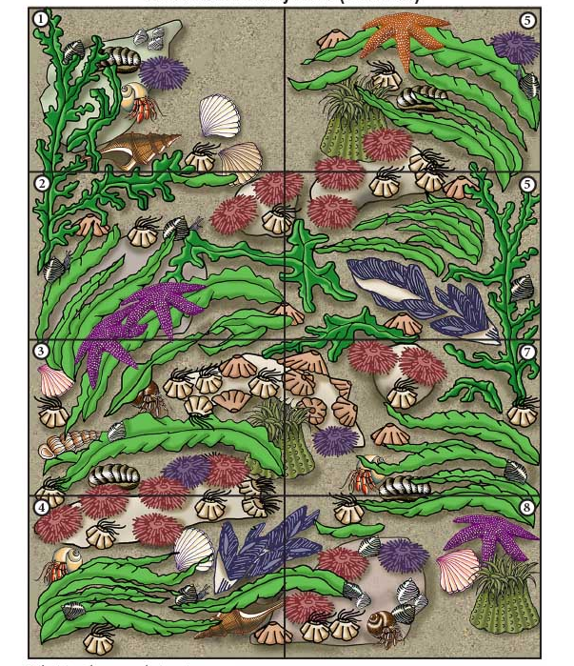
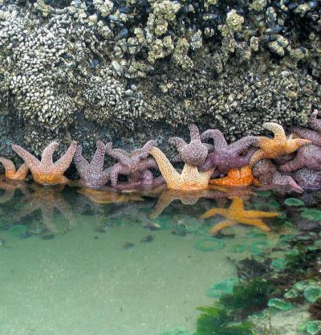

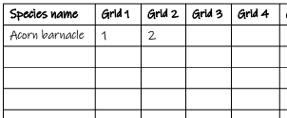
Activity 1: Evaluate tide pool biodiversity
Food for thought:
1. Have you ever been to a marine tide pool before?
2. Can you guess how many types of living creatures you can find at a tide pool?
3. Do you know how scientists study the biodiversity of the tide pool?
What you will need:
1 ruler
1 pencil
A tide pool organism key
A worksheet (next page)
2 images of 2 study sites
Step 1:
Start with Study Site A. Use the tide pool organism key to identify the organisms and count the number of each organism you see. Fill in the numbers!
Step 2:
Draw the transect sampling lines to split Study Site B into 6 small equal-size grids (3 rows x 2 columns). Number each grid from 1 to 6
1
4
2
5
3
6
Step 3:
Identify, Count and Fill in the number of organisms you see in Study Site B to the worksheet
Let’s discuss
1. Which study site has more types of organisms?
2. Which study site has more total organisms (including organisms of the same type)?
3. As a result, which study site is more diverse?
Add your final answers here (after filling the 2 worksheets)
This activity is self explanatory, and the teacher can ask one student to fill in one organism or one site at a time then take turn.

Slide 4
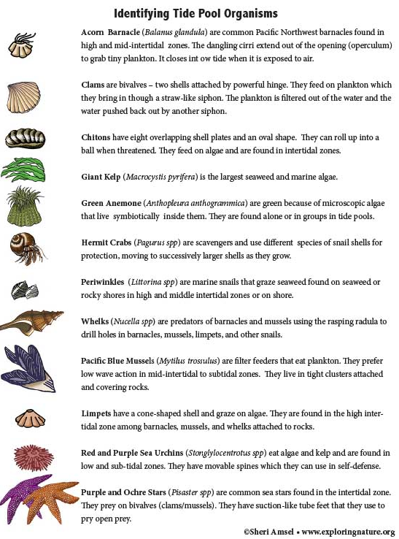
Activity 1: Evaluate tide pool biodiversity

Slide 5
Activity 1: Evaluate tide pool biodiversity
Study Site A

Slide 6
Activity 1: Evaluate tide pool biodiversity
Worksheet for Study Site A
List the name of all the organisms that you see in Study Site A in the first column
Fill in the number of each organism that you see in each Grid
Species name | Grid 1 | Grid 2 | Grid 3 | Grid 4 | Grid 5 | Grid 6 | Grid 7 | Grid 8
Acorn barnacle | 1 | 2
N1= Total # of organisms
N2= Total # of organism types
Diversity index =N2/N1
Biodiversity (Lo, Med, Hi)
3. Per Study Site A (combination of all 8 grids):
N1 = …………… N2 = ……………. Diversity index = …………….. Biodiversity: …………………………………

Slide 7
Activity 1: Evaluate tide pool biodiversity
Study Site B

Slide 8
Activity 1: Evaluate tide pool biodiversity
Worksheet for Study Site B
List the name of all the organisms that you see in Study Site B in the first column
Fill in the number of each organism that you see in each Grid
Species name | Grid 1 | Grid 2 | Grid 3 | Grid 4 | Grid 5 | Grid 6
N1= Total # of organisms
N2= Total # of organism types
Diversity index =N2/N1
Biodiversity (Lo, Med, Hi)
3. Per Study Site B (combination of all 6 grids):
N1 = …………… N2 = ……………. Diversity index = …………….. Biodiversity: …………………………………

Slide 9
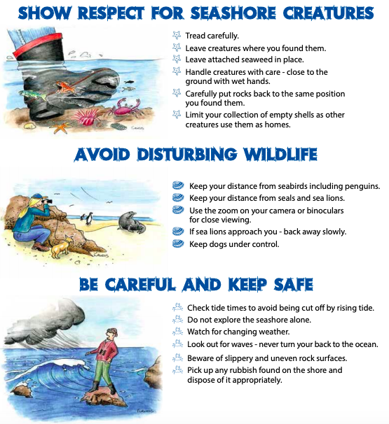
Activity 2: Human impacts on the tide pool diversity
Food for thought:
As beach-goers, what you wish to do to protect the tidal habitat?
As a fisherman, what can you do to protect the tide pool organisms?
As city leader, what can you do to protect the beach and tide pool?
What you will need:
1 pencil
A worksheet (next page)
Step 1:
Let’s divide into 3 groups to represent different groups of people to discuss our environmental action!
Group 1: Beach-goers
Group 2: Fishermen
Group 3: City leaders
Step 2:
Among your group, let’s discuss in 25 minutes the following questions for the tide pool in Southern California coast.
What is the issue?
What is the goal of your group?
What skills will we need?
Who could influence the decision?
What are the actions?
How will we find out what people think and feel about the issue?
How can we make people more aware of the issue?
What information do we need and where we will find it?
Let’s share the action sheet from your group to the class!
The teacher’s responsibility here is to facilitate the discussion among groups and provide summary with some possible action items gathered from the group

Slide 10
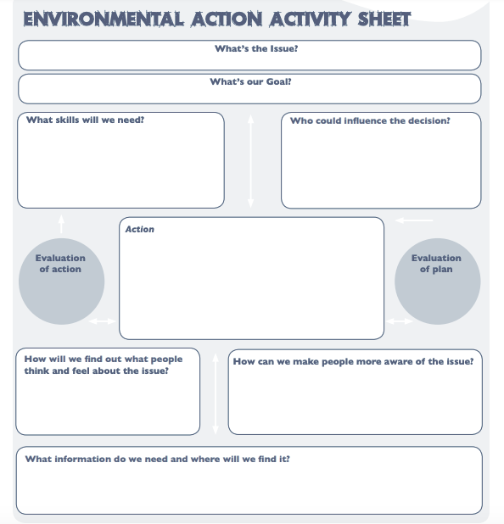
Activity 2: Human impacts on the tide pool diversity
Group that you belong: Beach-goers Fishermen City leaders
(draw a circle)

